Slide 1
Maintaining, Updating, and
Protecting Windows 10
Lesson 7

Slide 2
Objectives
Skill/Concept | Exam Objective | Objective Number
Exploring Built-In Maintenance Tools | Configure desktop settings Understand storage Understand maintenance tools | 1.2 5.2 6.2
Maintaining the Windows Registry | (None) | (None)
Configuring and Managing Updates | Configure updates | 6.3
Defending Your System From Malicious Software | Configure antivirus settings | 3.3

Slide 3
Built-In Maintenance Tools
Windows 10 comes with many built-in maintenance tools that help to keep computers running at top performance:
Disk Defragmenter
Disk Cleanup
Task Scheduler
Action Center

Slide 4
Disk Defragmenter (1/2)
Disk Defragmenter is a utility that helps improve your computer’s performance by moving sectors of data on the hard disk, so that files are stored sequentially.
This minimizes the movement a hard disk’s arm must make to read all of the sectors that make up a file or program.

Slide 5
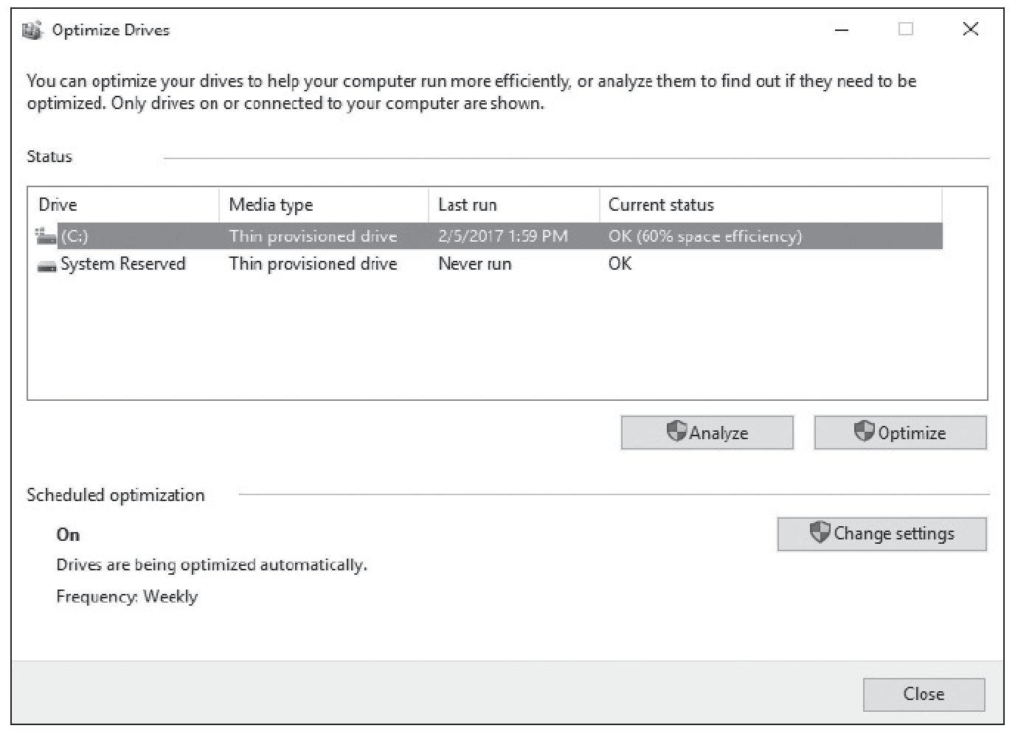
Disk Defragmenter (2/2)

Slide 6
Disk Cleanup (1/2)
Helps users remove unnecessary files from their computers:
  Downloaded program files
  Temporary internet files
  Offline Web pages
  Files left after running software
  More

Slide 7
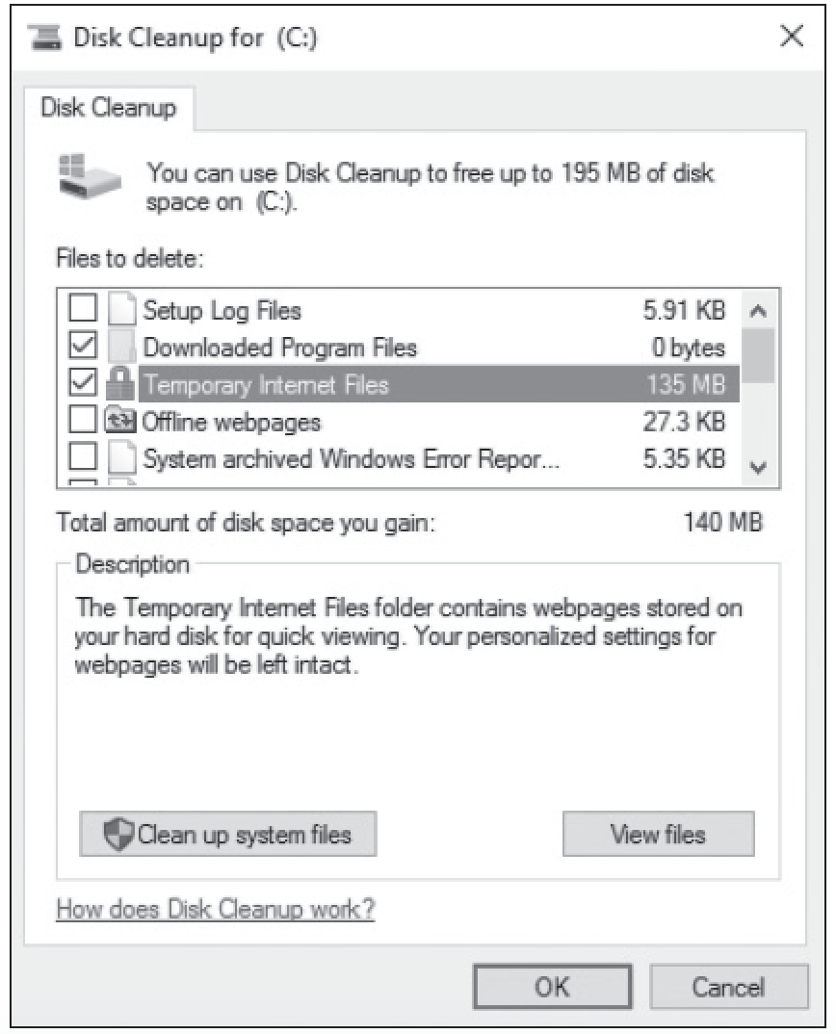
Disk Cleanup (2/2)

Slide 8
Task Scheduler
Task Scheduler enables you to schedule and automate a variety of actions, such as starting programs, displaying messages, and even sending emails.
You create a scheduled task by specifying a trigger, which is an event that causes a task to run, and an action, which is the action taken when the task runs.

Slide 9
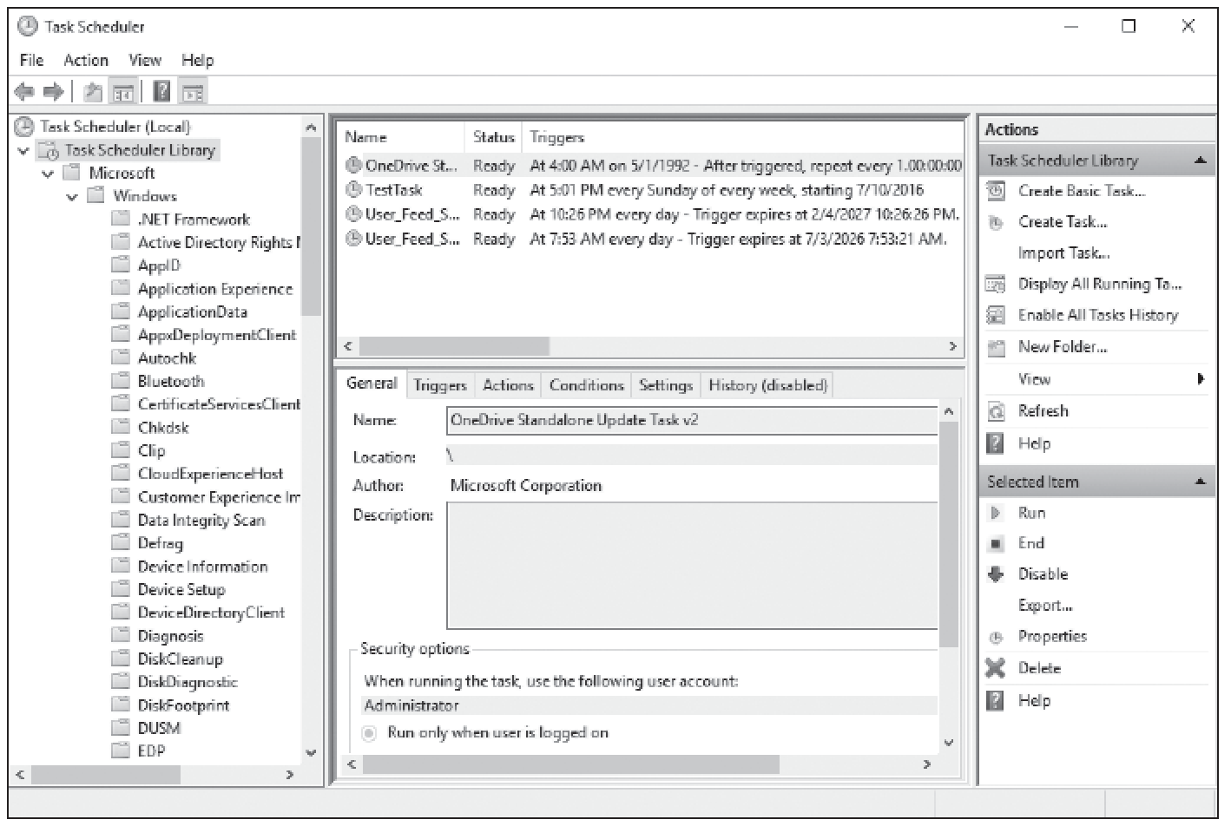
The Main Task Scheduler Window

Slide 10
Using Action Center (1/2)
Windows 10 Action Center is an improvement upon Security Center in previous versions of Windows.
Within Action Center, you can view notifications for security features (firewall, antivirus software, and so on) and maintenance (backups, updates, and so on).

Slide 11
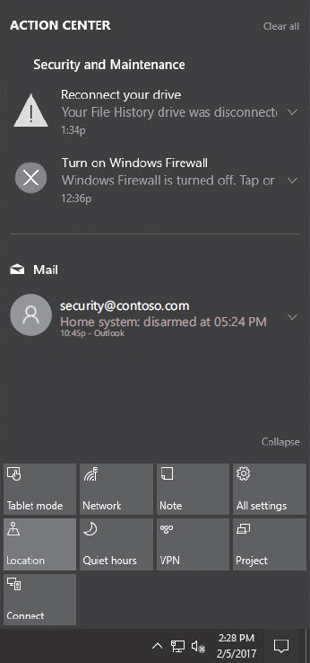
Using Action Center (2/2)

Slide 12
System Information
System Information displays a wealth of information about your computer’s hardware, drivers, and system software.
If you’re having any type of system-related issues, you should check System Information for possible clues as to the source of the problem.

Slide 13
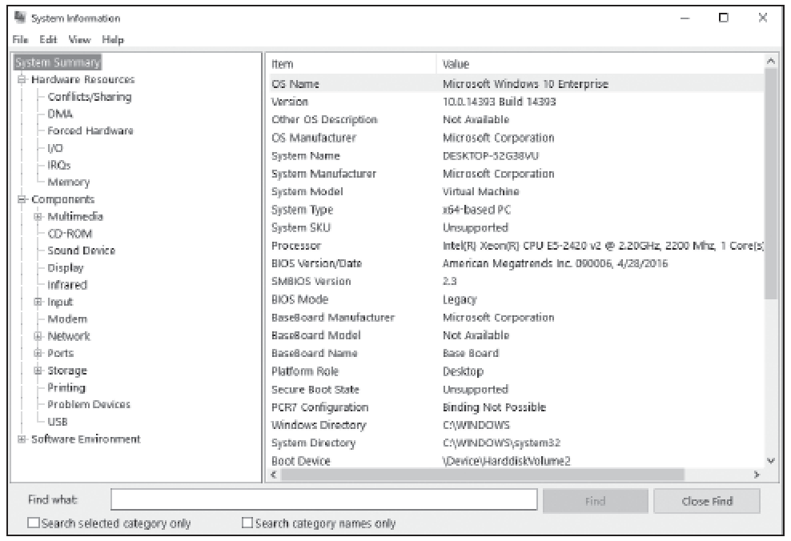
The System Information Window

Slide 14
Maintaining the Windows Registry
The Windows registry is a database in Windows that stores user preferences, file locations, program configuration settings, startup information, hardware settings, and more.
The registry stores the associations between file types and the applications that use them.

Slide 15
Configuring and Managing Updates
Microsoft routinely releases security updates on the second Tuesday of each month, commonly known as Patch Tuesday.
Although most updates are released on Patch Tuesday, there might be occasional patches (known as out-of-band patches) released at other times when the patches are deemed critical or time-sensitive.

Slide 16
Configuring Windows Update Options
Windows Update provides your Windows 10 users with a way to keep their computers current by checking a designated server.
The server provides software that patches security issues, installs updates that make Windows and your applications more stable, fixes issues with existing Windows programs, and provides new features.
Notes:
The server can be hosted by Microsoft or it can be set up and managed in your organization by running the Windows Server Update Services (WSUS) or System Center 2012 R2/2016 Configuration Manager.

Slide 17
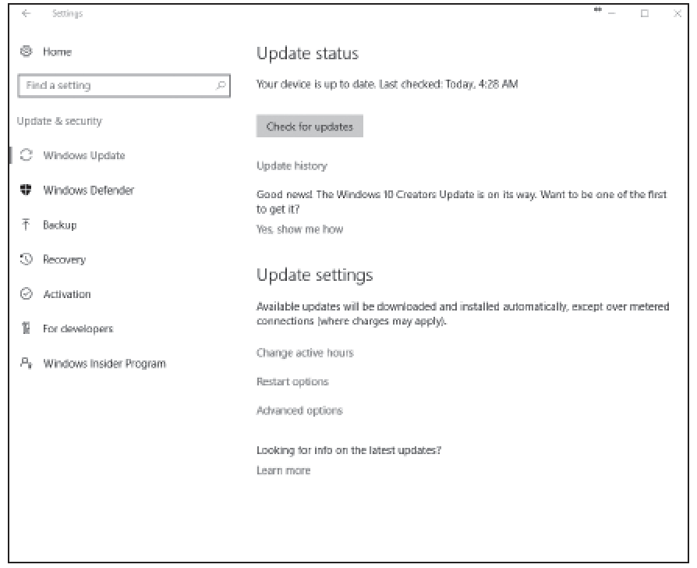
The Windows Update Page

Slide 18
Managing Update History and Rolling Back Updates
You can view your update history by clicking the Update history option.
On the Update history page, each update, includes the KB article number and the date installed.
If you click Successfully installed on <date> for a specific update, it provides a short description of the update.

Slide 19
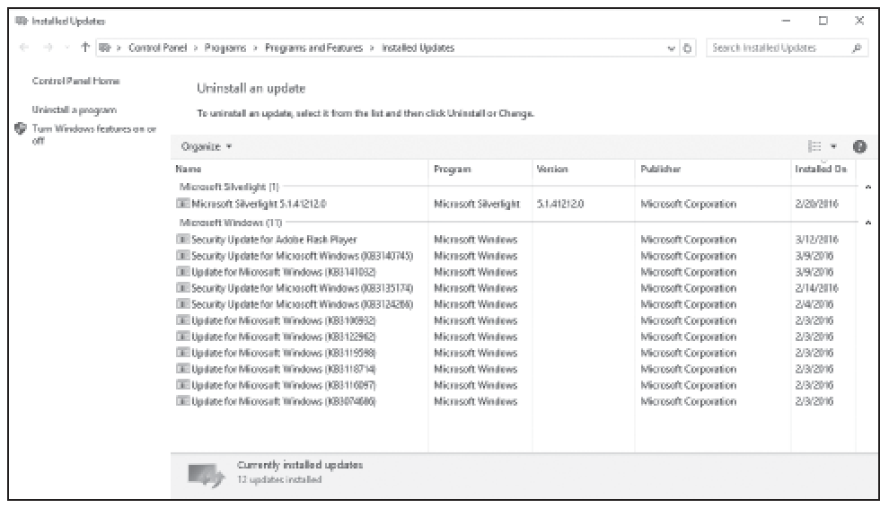
The Installed Updates Page

Slide 20
Implementing Insider Preview
The Windows Insider program (previously accessible to developers only) allowed users to sign up for early builds of the Windows operating system.
Today, the program has been expanded to include enterprise testers and advanced users.
This enables Microsoft to get feedback before a new feature or update is released to the general public and is a way to test upcoming Windows features before they are released to the general public.

Slide 21
Implementing CB, CBB, and LTSB Scenarios
(1/2)
Enterprise companies are usually not willing to upgrade to the newest version of Windows, and most responsible corporations would deploy the monthly updates that Microsoft publishes every month.
However, these corporations are not usually willing to deploy new or updated features because they can cause a wide range of problems.

Slide 22
Implementing CB, CBB, and LTSB Scenarios
(2/2)
So rather than force the new and updated features to corporations, Microsoft has developed Windows 10 servicing options, which allow you to configure devices into one of three tiers based on how often you want these features deployed.

Slide 23
Windows 10 Servicing Options
Servicing Option | Availability of New or Upgraded Features | Minimum Length of Servicing Lifetime | Supported Editions
Current Branch (CB) servicing | Receives upgrades immediately after Microsoft makes them publicly available | Approximately 4 months | Home, Pro, Education, Enterprise, IoT Core, Windows 10 IoT Core Pro (IoT core Pro)
Current Branch for Business (CBB) servicing | Defers receiving feature upgrades for 4 months after Microsoft makes them publicly available | Approximately 8 months | Pro, Education, Enterprise, IoT Core Pro
Long-Term Servicing Branch (LTSB) | Are available immediately after being published by Microsoft, but allows for long-term deployment of selected Windows 10 releases in low-change configuration (up to 10 years) | 10 years | Enterprise LTSB

Slide 24
Defending from Malicious Software
One of the most challenging problems for computer users and administrators is to prevent viruses, worms, and other types of malware from infecting your computer.
To protect against malicious software, make sure your system is updated, you are using a firewall to limit exposure to malware, and you are using an up-to-date anti-malware software package.

Slide 25
Understanding Windows Firewall
Windows Firewall comes with Windows 10 and other Windows versions to protect your computer from traffic entering through communications ports.
A firewall is a software program or device that monitors traffic entering and leaving a computer.
Notes:
Take Note: Networks have firewalls, too—they are similar to computer firewalls, but are usually much more robust.

Slide 26
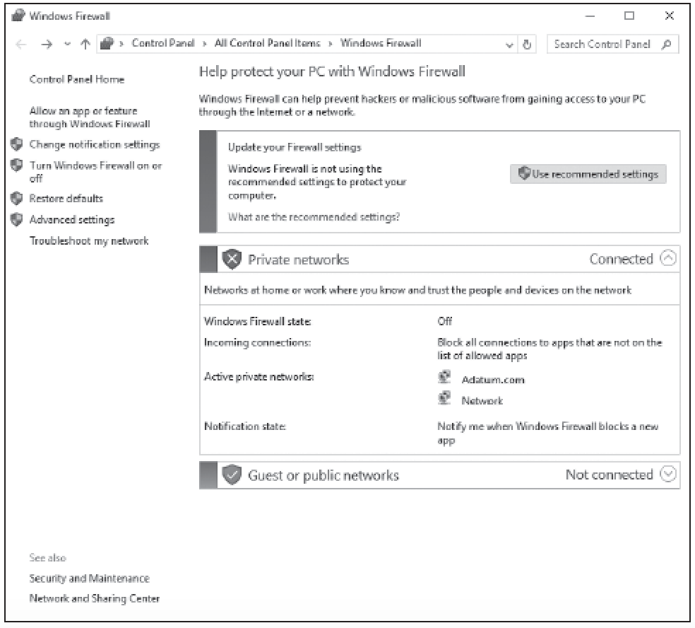
The Windows Firewall Page

Slide 27
Managing Client Security Using Windows Defender
Windows Defender is designed to protect your computer against viruses, spyware, and other types of malware.
It protects against these threats by providing real-time protection in which it notifies you if malware attempts to install itself on your computer or when an application tries to change critical settings.
Notes:
Microsoft Security Essentials is updated regularly by the Microsoft Update service to ensure the signatures, the anti-malware engine, and the application itself are kept up to date.
A signature is a sequence of text or code that’s programmed into a virus and uniquely identifies it. An anti-malware engine is the search process antivirus software uses to find viruses and other malware on a computer. Because new threats appear every day, Security Essentials downloads new signatures daily and uses the Dynamic Signature Service to push the updates to your computer almost immediately.

Slide 28
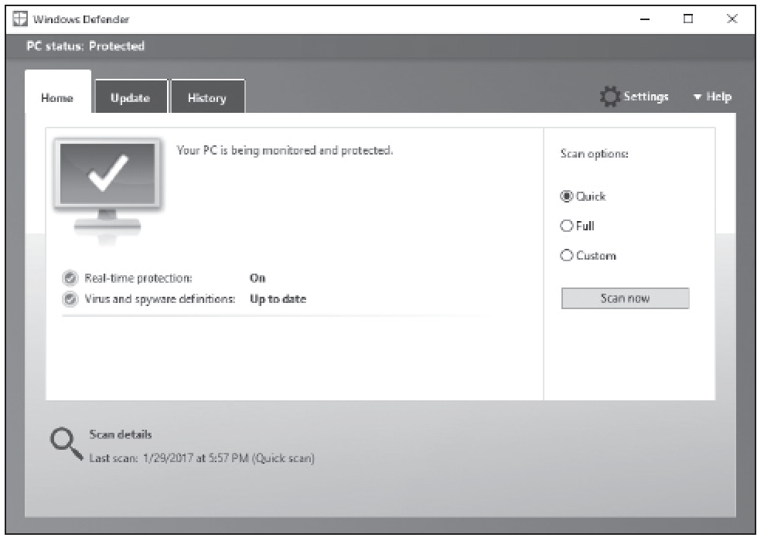
Windows Defender Home Tab

Slide 29
Summary (1/5)
Windows 10 comes with many built-in maintenance tools that can help to keep computers running at top performance.
These tools include Disk Defragmenter, Disk Cleanup, Task Scheduler, and the Action Center Maintenance feature.

Slide 30
Summary (2/5)
Disk Defragmenter is a utility that helps improve your computer’s performance by moving sectors of data on the hard disk, so that files are stored sequentially.
This minimizes the movement a hard disk’s arm must make to read all the sectors that make up a file or program.

Slide 31
Summary (3/5)
Task Scheduler enables you to schedule and automate a variety of actions, such as starting programs, displaying messages, and even sending emails.
You create a scheduled task by specifying a trigger, which is an event that causes a task to run, and an action to be taken when the task runs.

Slide 32
Summary (4/5)
Intruders and some viruses, worms, rootkits, spyware, and adware gain access to a system by exploiting security holes in Windows, Internet Explorer, Microsoft Office, or other software applications.
Therefore, the first step you should take to protect yourself against malware is to keep your system up to date with the latest service packs, security patches, and other critical fixes.

Slide 33
Summary (5/5)
One of the most challenging problems for computer users and administrators is to prevent viruses, worms, and other types of malware from infecting your computer.
To protect against malicious software, make sure your system is updated, you are using a firewall to limit exposure to malware, and you are using an up-to-date anti-malware software package.

